Slide 1
History/Conflict of Jerusalem
By: Sarah Kane & Aj Tapa’atoutai
Period:B4

Slide 2
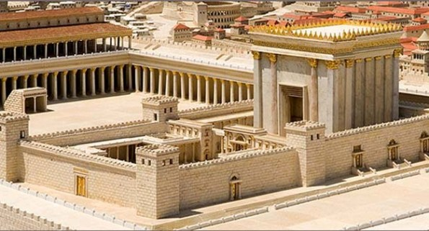
423 BCE
The Babylonians conquered Israel & destroyed the Temple and exiled the Jews
First Temple

Slide 3
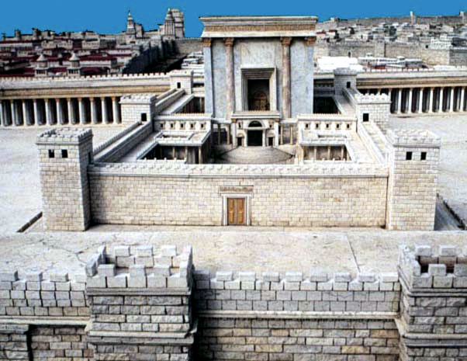
352 BCE
The Temple was rebuilt and stood for another 400 years.
70 CE The Romans destroyed the second Temple.

Slide 4
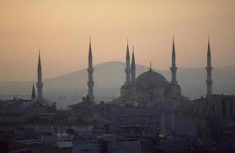
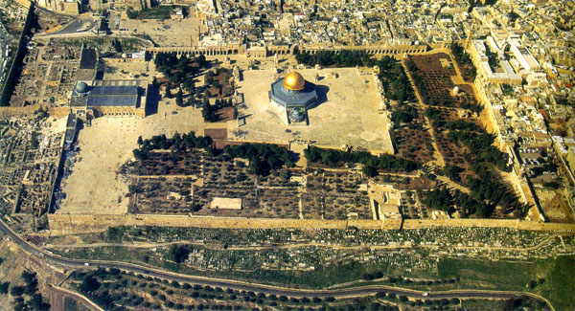
312 The Christians ruled Israel for 300 years and Jews could not live in Jerusalem. 638 The Muslims conquered Israel and Jerusalem. Jews were allowed to come back, they also
built their mosques atop Judaism’s holiest
site the Temple Mount
Temple
Mount

Slide 5
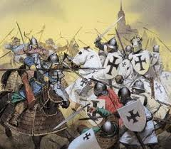
1099 The Christians defeat the Muslims and kill all the Jews in Jerusalem.
From the time of the destruction of the Temple, no foreign ruler paid much attention to Jerusalem and it became a poor, run down city that suffered from a lack of clean water, from disease, and from robbers. Despite this, Jews everywhere dreamed of returning to Jerusalem and many literally risked their lives to travel and settle there. The Western Wall, the last remnant of the Temple, was the holiest place in Jerusalem for prayer.

Slide 6
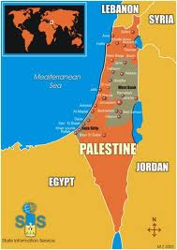
1500
Though Jews were scattered all over the world, many made heroic efforts to move to Israel and settle in Jerusalem.
1517
The Turkish empire conquered Israel & Jerusalem , They ruled for over 400 years.
1917
The British conquered Jerusalem & Israel in World War 1
This is a picture of how Israel and the
Palestine are split.

Slide 7
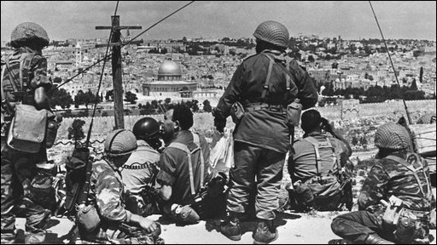
1850 - 1948 .
Over the centuries the Jewish population grew, Until there were 10,000 Jews living in the city in 1850.
1948
Israel fought and won the War of Independence, but lost Jerusalem to the Jordanian forces.
1967
The Jews were cut off from the heart of Jerusalem. The Arabs plan to attack & destroy Jewish State. Israel won the war in just six days. (Six day war)

Slide 8
1980s
Shia groups came into Hizbullah and Amal going against Israel and partnering with remnants of Palestinian Organizations that planned to attack Galilee.
2000s
President Bill Clinton got Palestinian Leader (Yasser Arafat) and Israeli Prime Minister (Ehud Barak) to sign a peace treaty.
- Battle of Gaza: A military conflict of Hamas against Fatah taking place at the Gaza Strip.

Slide 9
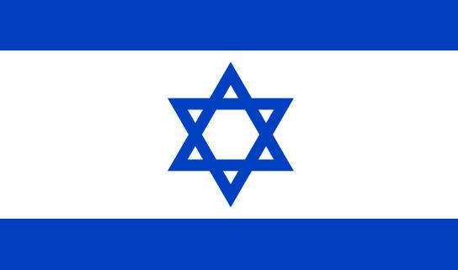
The Flag of Israel was adopted on October, 28, 1948

Slide 10
The
End

