Slide 1
Cairo , Egypt
Presentation by: A.j. Tapa’atoutai

Slide 2
Population=
17 MILLLION !!

Slide 3
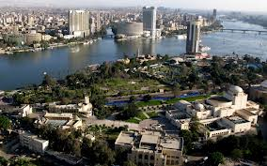
Aerial views of Cairo

Slide 4
Fun fact 1
-Cairo is home to the only remaining ancient wonder of the world

Slide 5
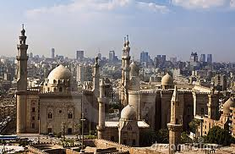
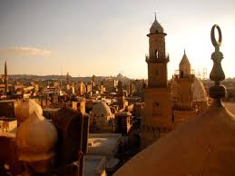
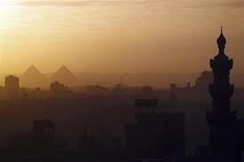
Skyline Views of Cairo

Slide 6
Fun fact 2
-The Nile runs through Cairo, and there are two large islands in the middle of the city.

Slide 7
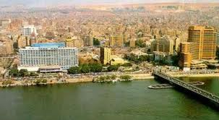
Picture of the city

Slide 8
Fun Fact 3
Cairo was founded in 969 by the Fatimid Caliphate from Tunisia

Slide 9
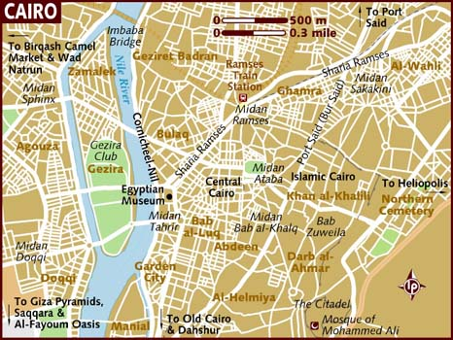
Maps

Slide 10
Credits
Google
Google images
http://www.nileguide.com/destination/cairo/overview/local-info
http://www.tripadvisor.com/Attractions-g294201-Activities-c50-Cairo_Cairo_Governorate.html
http://travel.travelocity.com/flights/InitialSearch.do?Service=TRAVELOCITY&flightType=roundtrip&dateTypeSelect=exactDates&dateLeavingTime=Anytime&dateReturningTime=Anytime&adults=2&children=0&seniors=0&leavingDate=12/2/2013&returningDate=12/7/2013&leavingFrom=SLC&goingTo=NYC&WA1=03010&WA2=tripadvisor.com&WA5=trave_air_dated_B1_|u&WA6=air&WA8=New%20York%20City,New%20York,United%20States&utm_source=tripadvisor&utm_medium=meta&utm_term=New%20York%20City,New%20York,United%20States&utm_content=trave_air_dated_B1_|u&utm_campaign=promo

