Slide 1
Bill & Steve Gates Jobs
Aj Tapa’atoutai
11.27.2012
Pd. A2

Slide 2
outline
In my presentation I will show you who (out of Bill Gates & Steve Jobs) did the most work. And How that person put the most effort into their work.
Thesis Statement: Who did more work Bill or Steve?
Also what did they invent?

Slide 3
Bill gates
Bill Gate is an American business magnate and philanthropist.
Born on October 28, 1955 in Seattle, Washington
One of the worlds wealthiest people
Bill Gates created the windows of Microsoft (ex. Windows 98, 99, ME, 2000, XP, Etc.) He also invented Internet Explorer.
First Microsoft retail launched on November 20,1981
1987: Gates becomes the youngest billionaire ever
1989: Gates found Corbis, an archive of art and photography from public
1999: He publishes another best-selling book, Business @ Speed of Thought
2000: Gates steps down as CEO Microsoft
2001: DOJ announces that it is no longer seeking to break up Microsoft and will instead seek a lesser antitrust penalty

Slide 4
Bill Gates
2005: Queen Elizabeth II bestows an honorary knighthood on Gates for his contributions to the United Kingdom.
2006: Gates announced that he will phase out for the following two years w/ the role as an executive at Microsoft.
2007: Gates finally graduates from Harvard; the university gives him a honorary degree
2008: Gates loses his place as the richest man on the planet.
2008:Gates retires from Microsoft on June 27, but stays in the role of chairman and adviser on important development projects.

Slide 5
Steve Jobs
Born: Feb. 24, 1955(Was adopted by Paul and Clara Jobs)
Apr. 1, 1976: Established Apple Computer
Jul. 1976:The first product of Apple 1 goes on sale
Apr. 19, 1977: Apple’s first mainstream computer the Apple 2
Dec. 12, 1980: Apple establishes its headquarters in Cali.
Jan. 19, 1983: The Apple Lisa was introduced. Costing $9,995 failing in market.
1983: Apple goes into schools.
Jan. 24, 1984: Apple introduces the first Macintosh (One of the first personal computers to use a graphical user interface)
Mar. 2, 1987: The Macintosh 2 was introduced
Jun. 16, 1991: The PowerBook the first truly successful computer that is portable is introduced.
Nov. 22,1995: Steve buys Pixar.
May 6, 1998: Apple introduces the iMac.

Slide 6
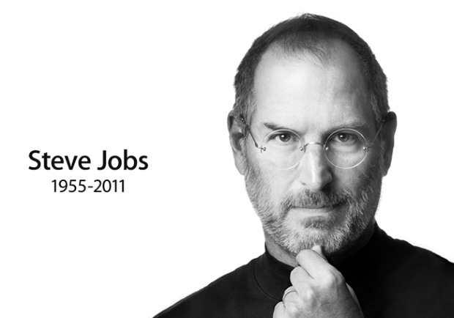
Steve Jobs
2000’s: Jobs introduces the Power Mac G4 Cube
Apple enters the Retail market
The IPod was introduced
At 49 yrs. Old Jobs goes through surgery to remove a tumor
Steve introduced the IPhone in June of 2007
Steve temporarily steps down as CEO because of health problems
He gets a liver transplant
Steve Introduce the IPad
He takes another medical leave.
He comes back and introduces the new IPad
Apple becomes World’s Most Valuable Company
October 5, 2011: Steve Jobs Dies at age 56

Slide 7
My opinion
My opinion on who did more work was hard to choose because I thought that both Steve Jobs and Bill Gates help give the world of electronic a gain. The both are very dedicated to their work. But then again I think Steve Jobs did more work and made more inventions.
They both made a huge difference in computers. Steve Jobs made lots of inventions. That most people have today for example the IPod, IPad, IPhone, Etc. And Bill Gates invented Internet Explorer and Microsoft. Which everyone uses today also.

Slide 8
Reference
http://en.wikipedia.org/wiki/Bill_Gates
http://www.npr.org/news/graphics/2008/june/bill_gates/gates_timeline_04.html
http://www.nytimes.com/interactive/2011/10/05/business/20111005jobs-life-timeline.html
http://www.google.com/
http://en.wikipedia.org/wiki/Steve_Jobs
http://en.wikipedia.org/wiki/Bill_Gates

Slide 9
The End

